Slide 1


Coffee Shop Sales Performance Analysis
Md Mushtaq

Slide 2



Business Problem: The main objective of this project is to analyse retail sales data to gain actionable insights that will enhance the performance of the Coffee Shop.

Slide 3
Research Questions:
How do sales vary by day of the week and hour of the day?
Are there any peak times for sales activity?
What is the total sales revenue for each month?
what is the average price/order per person?
How do sales vary across different store locations?
Which products are the bestselling in terms of quantity and revenue?
How do sales vary by product category and type?

Slide 4

Introduction
Welcome to the Coffee Shop Sales Performance Analysis Report. In this report, we dive deep into the sales data of the Coffee Shop to uncover insights that will drive strategic decision-making and enhance business performance. By leveraging data analytics, we aim to optimize operations, maximize profitability, and elevate the overall customer experience. Join us as we explore the transformative potential of data in shaping the future of the Coffee Shop.

Slide 5
Methodology
In the pursuit of illuminating insights, we meticulously gathered data from the Coffee Shop's sales records, ensuring a comprehensive understanding of its operational dynamics. Employing sophisticated analytical tools and techniques, specifically pivot tables and measures using MS Excel and Creating Visualisation in form of Dashboard, we orchestrated a symphony of data organization and analysis. Through this methodical approach, we excavated invaluable insights, unveiling hidden patterns and trends within the labyrinth of sales data. This rigorous methodology forms the bedrock of our endeavour to unearth actionable intelligence and drive informed decision-making.

Slide 6


Analysis, Findings, Visualizations and Insights

Slide 7
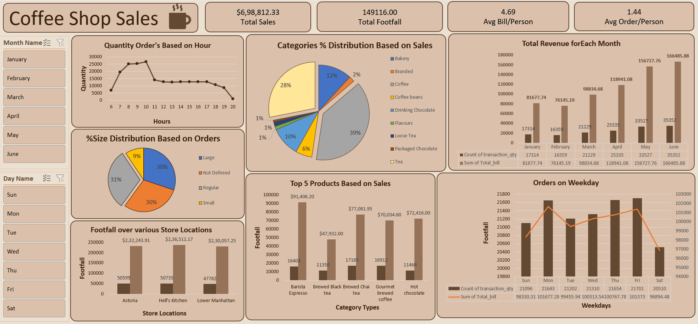
Dashboard of Analysis on Coffee Shop Sales

Slide 8
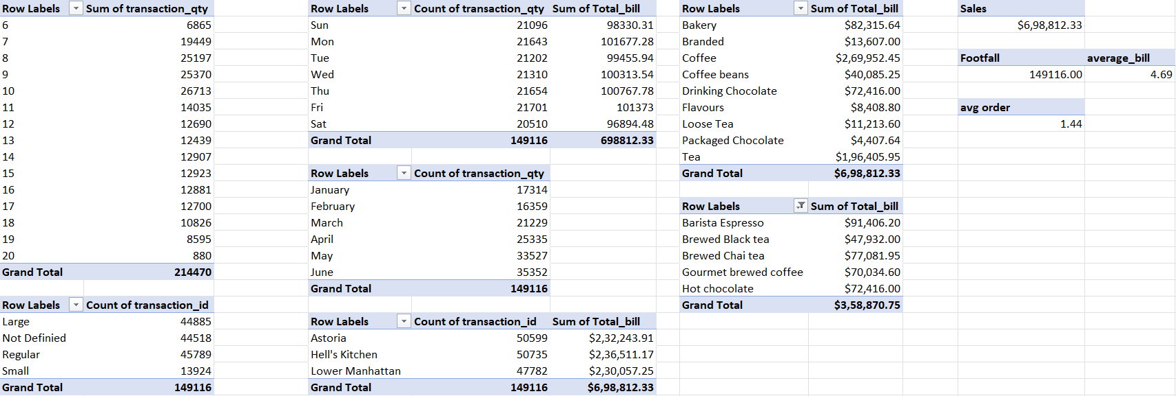

Pivot Tables for the above Dashboard

Slide 9
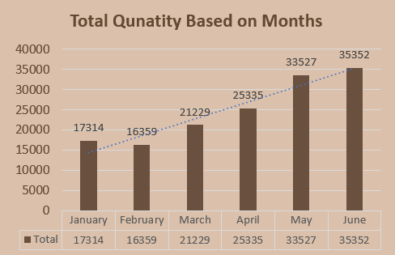
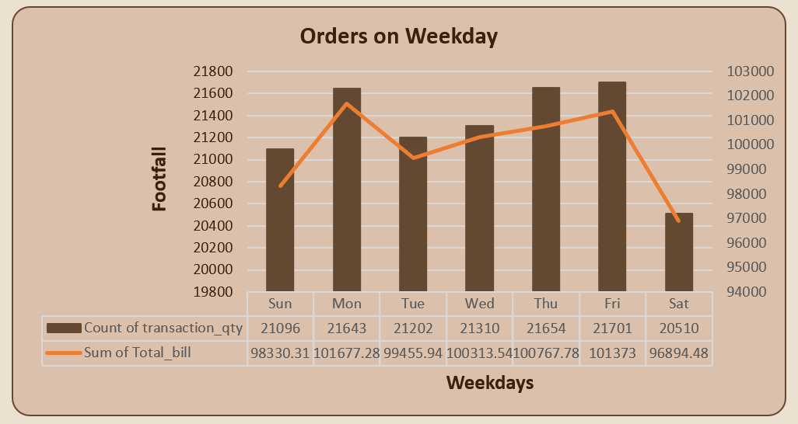
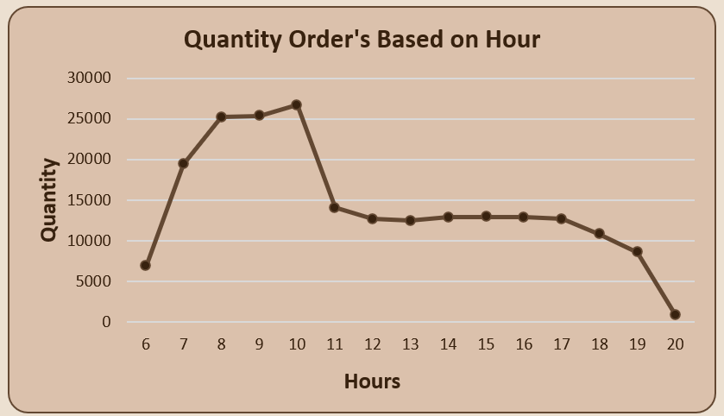
Sales Variation by Day of the Week and Hour of the Day & Monthly Basis:
graph(1)
graph(2)
From graph(1), bar graph show’s here the difference in starting months and end months is varying as, June month having highest count of orders of 35352 which is more than double the month of Feb, as recorded among all months.
From graph(2), combo chart of bar graph and line Shows here is, weekends and weekdays see varying levels of sales activity, Mon/Thu/Fri see the highest customer traffic, where on all Friday’s the count of orders is 21701 with Total bill of $101373.Saturday have lower footfall. Targeting weekends promotions & giving combo offer’s could attract more customers during these times.
From graph(3), line graph show’s the peak sales hours occur during morning time, particularly between 8AM to 10AM.
The highest sales quantity hour is 10AM which have the total sum of quantity is 26713 & lowest is 880 at 8PM.
graph(3)

Slide 10
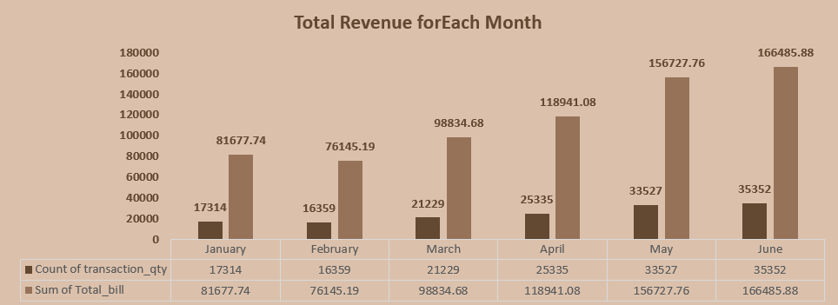
Total Sales Revenue for Each Month:
From above bar graph see the Sales revenue fluctuates throughout the year, with notable peaks during May and June having the revenue of Total bill $156728 & $166486 and Lowest revenue collected in the month of February of Total bill $76150.
Seasonal trends should be considered when planning promotional activities and inventory management.

Slide 11
Sales Performance by Day of the Week:
Monday (Mon) has the highest total sales revenue among weekdays, with ₹101,677.28.
Friday (Fri) follows closely behind, with total sales of ₹101,373.
Sunday (Sun) has the highest total sales revenue among weekends, with ₹98,330.31.
Saturday (Sat) has slightly lower total sales compared to other weekend days, with ₹96,894.48.
Overall, Monday and Friday appear to be the strongest sales days, while Saturday has slightly lower sales compared to other week days.
.
Sales Performance by Month:
June has the highest total sales revenue, with ₹353,520.
May follows closely behind, with total sales of ₹335,270.
February has the lowest total sales among the months provided, with ₹16,359.
There is a noticeable increase in sales from January to June, indicating potential seasonality or other factors influencing sales trends.
Average Bill/Person & Average Order/Person :
The average bill per person is $ 4.69.
The average order per person is 1.44, which very low & it indicating potential for increasing average order value through strategic pricing or promotional offers.

Slide 12
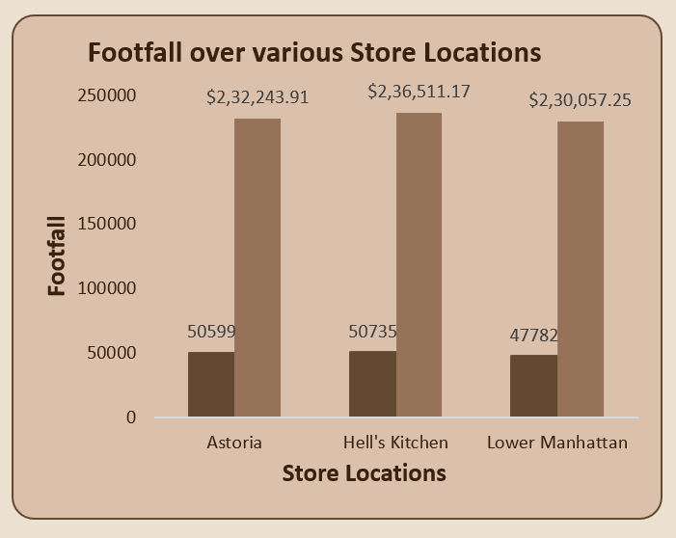
Sales Variation Across Different Store Locations:
From above bar graph see the Sales performance varies among store locations, with Astoria, Hell's Kitchen are the top-performing locations and Lower Manhattan being the low-performing location on basis of Transaction quantity count where the deference is around 3000 which is high. But when the total bill is compared approximately all location have same.
So, Investigate factors contributing to differences in sales among locations and implement strategies to optimize performance.

Slide 13
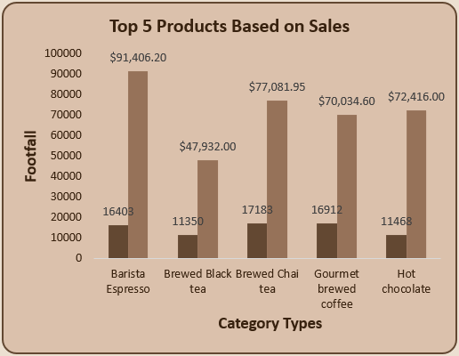
Best Selling Products:
Top Sellers:
Barista Espresso leads in revenue and Brewed Chai tea leads in quantity, indicating there popularity and contribution to overall sales.
Diversity in Preferences:
Customers show a preference for a variety of beverages, with Brewed Chai tea and Gourmet brewed coffee also ranking high in sales.
Revenue Impact:
Barista Espresso significantly contributes to the Coffee Shop's revenue, indicating its popularity and potentially higher price point compared to other products. This insight underscores the importance of promoting and maintaining the quality of this flagship product.
Strategic Opportunities:
Promoting bundled deals featuring popular items and managing inventory based on sales data can optimize sales and operational efficiency.
Customer-Centric Approach:
Understanding customer preferences allows for tailored offerings, driving satisfaction and loyalty.

Slide 14
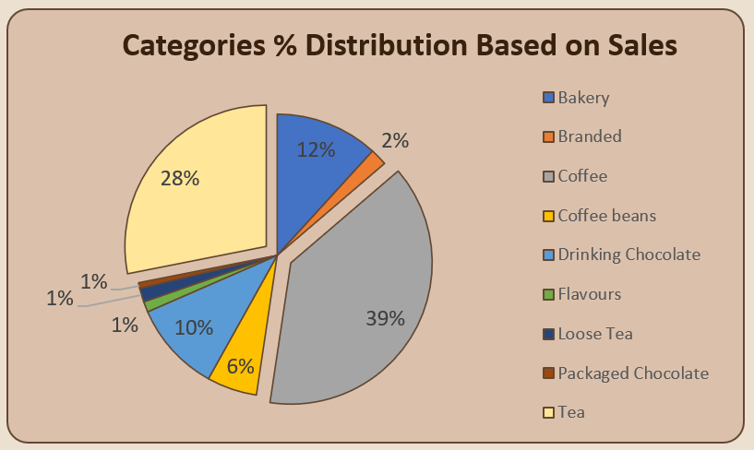
Sales Variation by Product category and Type:
Coffee:
Coffee emerges as the top-selling product category, contributing significantly to the Coffee Shop's total sales revenue.
It accounts for $269,952.45, indicating a strong preference for coffee-based beverages among customers.
Tea:
Following closely behind, tea ranks as the second-highest selling product category, with sales totalling $196,405.95.
This suggests that tea-based beverages are also popular among customers and contribute significantly to overall sales.
Drinking Chocolate:
Drinking Chocolate represents another noteworthy product category, contributing $72,416.00 to total sales revenue.
While it ranks lower than coffee and tea in terms of sales, it still makes a considerable contribution to the Coffee Shop's revenue stream.
Bakery:
Bakery items also make a notable contribution to sales, with total revenue of $82,315.64.
This category likely includes pastries, cakes, and other baked goods that complement the Coffee Shop's beverage offerings.
Other Categories:
The remaining product categories, including Coffee beans, Loose Tea, Branded items, Flavours, and Packaged Chocolate, contribute to sales but to a lesser extent compared to coffee, tea, drinking chocolate, and bakery items.

Slide 15
Insights on Sales Variation by Product Category:
Coffee and Tea:
Barista Espresso and Loose Tea are the top-selling products within their respective categories, contributing significantly to total sales revenue.
Drinking Chocolate:
While it generates less revenue compared to coffee and tea, Drinking Chocolate still makes a notable contribution to sales.
Bakery:
Bakery items, such as pastries and cakes, complement the beverage offerings and contribute to overall sales.
Coffee Beans:
While not as high in revenue as brewed coffee, sales of coffee beans add to the diversity of coffee offerings.
Other Categories:
Branded items, Flavours, and Packaged Chocolate contribute to sales but to a lesser extent compared to coffee, tea, and bakery products.
Offering a diverse range of products, including bakery items and drinking chocolate, enhances the Coffee Shop's appeal and caters to varying customer preferences.
Understanding sales variation by product category enables the Coffee Shop to optimize its product offerings, pricing strategies, and marketing efforts to maximize revenue and meet customer demand effectively.

Slide 16
Additional Insights:
Conduct correlation analysis to identify relationships between sales performance and external factors such as weather, holidays, or local events.
Explore customer segmentation based on demographic or behavioural data to tailor marketing strategies and promotions effectively.
Analyse customer feedback or reviews to identify areas for product or service improvement.
Recommendations:
Targeted Promotional Campaigns:
Develop promotions to boost sales during peak hours and attract more customers during off-peak times, maximizing footfall throughout the day.
Optimize Product Offerings:
Adjust product offerings based on sales trends and customer preferences, ensuring a diverse and appealing menu that resonates with customers.
Regular Store Performance Reviews:
Conduct routine evaluations of store performance to identify areas for improvement and adjust operations to enhance profitability continually.

Slide 17

Summary
This report provides valuable insights into the Coffee Shop's sales performance, highlighting key findings and actionable recommendations. By leveraging data-driven strategies, including targeted promotions, optimized product offerings, and regular performance reviews, the Coffee Shop can enhance operational efficiency, maximize profitability, and elevate the overall customer experience. This comprehensive analysis serves as a roadmap for driving growth and success in the competitive food service industry.

Slide 18

Thank you
Md Mushtaq
m.d.mushtaq0309@gmail.com
github.com/mushtaq0925
linkedin.com/in/md-mushtaq

